Slide 1
Chapter 2: Cells make up the human body

Slide 2
2.1 Cells
Cells
A cell is the smallest structure that can perform life’s functions.
The cell theory states that all organisms are made of cells, which are the basic unit of life and arise from pre-existing cells.
The structure of the human body, and the way in which it functions, result from the activities of all its cells.
Cells vary in size and shape, but all human cells have a similar basic structure.

Slide 3
2.2 Cell structure
Cells are made up of:
cell membrane – the outer boundary of the cell
cytoplasm – those parts of the cell within the cell membrane, except for the nucleus; includes the jelly-like fluid and the organelles suspended in it
organelles – structures suspended in the cytoplasm that carry out particular functions
cytosol – the liquid part of the cytoplasm
cytoskeleton – internal scaffolding of protein fibres within the cytoplasm
inclusions – chemical substances occurring as granules or liquid droplets in the cytoplasm.
The structures of the cell work together to meet the cell’s needs and allow it to fulfil its function.

Slide 4
2.2 Cell structure
Cell membrane
The cell membrane, or plasma membrane, separates the cell contents from the environment outside the cell and from neighbouring cells. It encloses the contents of the cell and controls what is able to enter and leave. It is very thin.
Cells of most organisms also have internal membranes; these form structures inside the cell called organelles.
Cytoplasm
Cytoplasm is the jelly-like or watery material inside the cell that fills all the space between the nucleus and the cell membrane. It is made up of the cytosol and organelles.
Cytosol
The cytosol is the liquid part of the cytoplasm. It is 75% to 90% water, with a complex mixture of dissolved substances such as salts and carbohydrates. Other compounds, such as proteins and fats, do not dissolve but are suspended in the watery fluid.
The cytosol is where most of the metabolic reactions occur.

Slide 5
2.2 Cell structure
Organelles
The structures within a cell are called organelles. Different types of organelle are specialised for particular functions.
Nucleus
The nucleus is the largest organelle in the cell and is usually oval or spherical in shape.
A nuclear membrane (actually a double membrane) separates the nucleus from the cytoplasm.
Nuclear pores in the nuclear membrane allow large molecules, such as messenger RNA, to enter and leave the nucleus.
Inside the nucleus is the DNA, which contains inherited information. DNA contains the information that determines the type of proteins a cell can make. In this way the nucleus, with its DNA, controls the structure of the cell and the way it functions.
Inside the nucleus, the nucleolus plays a part in manufacturing proteins.

Slide 6
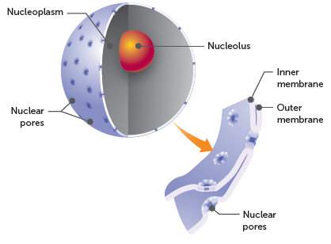
2.2 Cell structure
Structure of the nucleus showing the double membrane

Slide 7
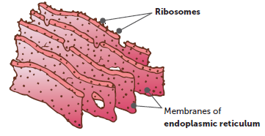
2.2 Cell structure
Ribosomes
Ribosomes are very small, spherical organelles. At the ribosomes, amino acids are joined together to make proteins. Ribosomes may be free in the cytoplasm or attached to membranes within the cells such as the endoplasmic reticulum.
Endoplasmic reticulum (ER)
The ER is a network of membranes forming channels through the cytoplasm of a cell; it is used for storage, support, synthesis and transport within the cell.
ER can be classified as rough (ribosomes attached to the outside of some membranes) or smooth (no ribosomes attached to the outside).

Slide 8
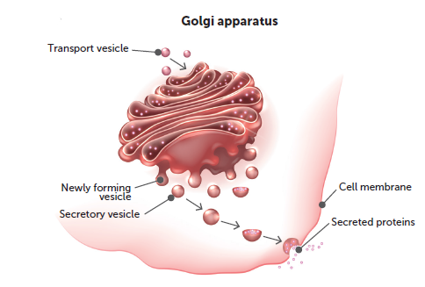
2.2 Cell structure
Golgi body
The Golgi body (sometimes called the Golgi apparatus) is a series of flattened membranes stacked one upon the other, usually positioned near the nucleus. Its function is to modify proteins and to package them for secretion from the cell.
Proteins produced at the ribosomes pass through the channels of the endoplasmic reticulum to the Golgi body. At the edges of the membranes of the Golgi body, small sacs of liquid containing proteins are formed. These sacs are surrounded by a membrane and are called vesicles.
Shutterstock.com/Tefi

Slide 9
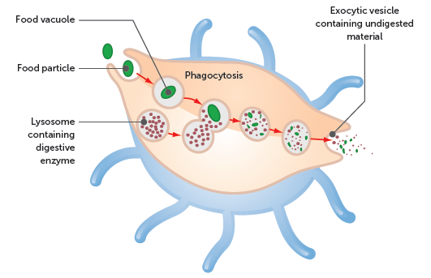
2.2 Cell structure
Lysosomes
Lysosomes are small spheres, bound by a membrane, that are formed from the Golgi body. They contain digestive enzymes that break down large molecules. When particles, or liquids, are taken into a cell they form vesicles in the cytoplasm. Lysosomes can join with these vesicles, and the digestive enzymes they contain break down the material inside the vesicle. Lysosomes also digest worn-out organelles in a similar way.

Slide 10
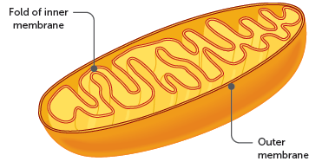
2.2 Cell structure
Mitochondria
Mitochondria are spherical or sausage-shaped structures that are spread throughout the cytoplasm. Each has a double membrane. The smooth outer membrane surrounds the mitochondrion, while the inner membrane, called the cristae, is arranged into a series of folds that extend into the interior of the organelle.
Some of the chemical reactions of cellular respiration occur in the mitochondria. The folding of the inner membrane produces a large surface area on which these chemical reactions can take place.

Slide 11
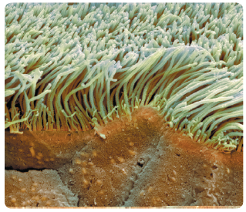
2.2 Cell structure
Cilia and flagella
Some cells have fine projections that can beat back and forth to move either the whole cell or substances over the surface of the cell. If the projections are short and numerous, resembling tiny hairs, they are called cilia. If they are longer, and there is only one or two of them, they are called flagella.
One place cilia occur is in the cells lining the trachea (see photo).
In humans, only the sperm cell has a flagellum.
Alamy Stock Photo/Science Photo Library

Slide 12
2.2 Cell structure
Cytoskeleton
The cytoskeleton is a framework of protein fibres that gives the cell its shape and assists cell movement. It consists of:
microtubules – hollow rods that keep organelles in place or move them around the cell
microfilaments – which move materials around the cytoplasm or move the whole cell.
Inclusions
Inclusions are chemical substances that are not part of the cell structure but are found in the cytoplasm of the cell. Examples include haemoglobin and the pigment melanin.

Slide 13
2.3 Cell requirements
Structure and function of the cell membrane
Each cell is surrounded by a cell membrane that separates the internal and external environment. Substances that enter or leave the cell must pass through this membrane.
The fluid mosaic model explains the structure and function of the cell membrane.
The membrane is said to be fluid because the molecules of which it is made are constantly changing position, and mosaic because it is composed of many different kinds of molecules.
The main structure of the membrane is composed of phospholipid molecules, which are lipid molecules containing a phosphate group. The phospholipids are arranged in two layers, known as a bilayer. Each phospholipid molecule has a head that is hydrophilic (water-loving), and a tail that is hydrophobic (water-hating).

Slide 14
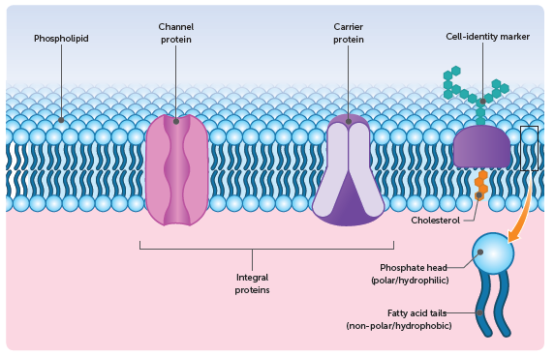
2.3 Cell requirements
Cholesterol and protein molecules are embedded in the phospholipid bilayer of the membrane. These molecules are important for the function integrity and stability of the membrane.
Cell membranes have a variety of protein molecules, including receptor proteins, channel proteins, carrier proteins and cell-identity markers.

Slide 15
2.3 Cell requirements
Functions of the cell membrane
The cell membrane has four main functions:
It acts as a physical barrier. The membrane separates the cell cytoplasm from the extracellular fluid around the cell.
It regulates the passage of materials. The membrane controls the movement of materials into and out of the cell.
It is sensitive to changes. The cell membrane is the first part of the cell affected by any changes in the extracellular fluid.
It helps support the cell. The internal part of the cell membrane is attached to the microfilaments of the cell’s cytoskeleton, giving support to the whole cell. There are also connections between the membranes of adjacent cells, providing support to the whole tissue.

Slide 16
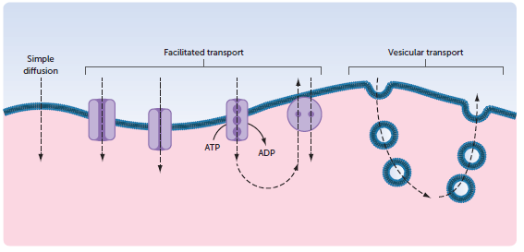
2.3 Cell requirements
Transport across the cell membrane
Cell membranes are differentially permeable, semipermeable or selectively permeable. This means that they allow certain ions and molecules to pass through but restrict the movement of others.
The transport of materials into and out of cells is controlled; this may occur by diffusion (passive process), facilitated transport (passive or active transport) or vesicular transport (active process).

Slide 17
2.3 Cell requirements
Diffusion
Diffusion is a passive process resulting from the random movement of ions and molecules.
Diffusion is the spreading out of particles so that they are evenly distributed over the space available. It occurs in gases and liquids because the molecules of gases and liquids are constantly moving.
The difference in concentration that brings about diffusion is called a concentration gradient, or diffusion gradient. The greater the difference in concentrations, the ‘steeper’ the diffusion gradient and the faster the rate of diffusion.
Simple diffusion is the process of substances moving along the concentration gradient in a solution or across a semipermeable membrane, without the use of membrane proteins.

Slide 18
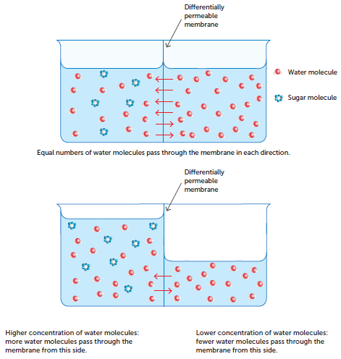
2.3 Cell requirements
Osmosis
Osmosis is the diffusion of a solvent through a differentially permeable membrane in order to balance the concentration of another substance. As water is the most important solvent in the human body, osmosis can be considered to be the diffusion of water across a differentially permeable membrane.
The water will move from an area where a solute such as sugar is in low concentration to an area where the solute is in high concentration.

Slide 19
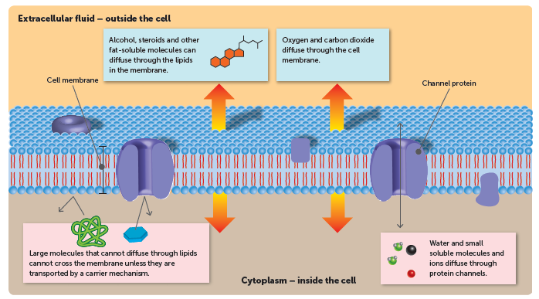
2.3 Cell requirements
Facilitated transport
In facilitated transport, proteins in the cell membrane allow molecules to be transported across the membrane. These proteins are channel proteins, which form protein channels, and carrier proteins, which allow carrier-mediated transport.
To diffuse across a cell membrane, water-soluble molecules must pass through protein channels in the membrane, allowing facilitated diffusion.

Slide 20
2.3 Cell requirements
While channel proteins provide a channel through the membrane, carrier proteins are only open on one side of the membrane at a time. When the specific substance binds to the binding site within the protein, the protein changes shape and opens to the other side. The substance can then be released on the side opposite to where is entered.
There are two main types of carrier-mediated transport.
1 Facilitated diffusion occurs when substances are transported through a protein along the concentration gradient, from a higher concentration on one side of the membrane to a lower concentration on the other. This is a passive process, as it does not require the input of energy.
2 Active transport requires energy in the form of ATP because substances are transported across the membrane against the concentration gradient, from lower to higher concentration. The process is similar to that of facilitated diffusion via carrier proteins, but it does not depend on a concentration gradient.

Slide 21
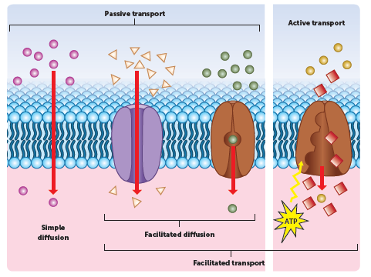
2.3 Cell requirements

Slide 22
2.3 Cell requirements
Vesicular transport
Vesicular transport is the movement of substances across the cell membrane in membranous sacs called vesicles. This is an active process, because energy from the cell is needed to form the vesicles.
Endocytosis is taking liquid or solids into the cell by vesicular transport. The cell membrane folds around a droplet of liquid or a solid particle until the droplet or particle is completely enclosed. The vesicle formed then pinches off and is suspended in the cell’s cytoplasm.
Exocytosis is when the contents of a vesicle inside the cell are passed to the outside. A vesicle that is formed inside the cell migrates to the cell membrane and fuses with the membrane. The contents of the vesicle are then pushed out into the extracellular fluid.

Slide 23
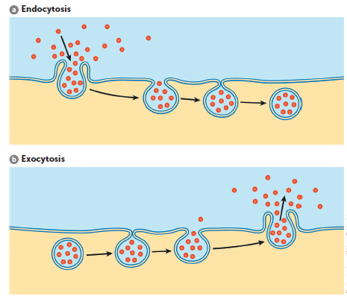
2.3 Cell requirements

Slide 24
2.3 Cell requirements
Why are cells so small?
There is a limit to how big a cell can be. All the requirements and products of a cell must pass across the membrane that surrounds the cell. The relationship between the surface area of the cell and the volume is very important.
A small cell will have a larger surface-area-to-volume ratio than a large cell.
As a cell grows, its ability to exchange enough materials to support its increasing volume is diminished because the volume increases at a greater rate than the surface area. A large cell could not support itself because it would not have enough surface to absorb the nutrients required, and remove the wastes produced, for its large volume. To function effectively, most cells have to be microscopic.
The surface-area-to-volume ratio limits the size of individual cells.

Slide 25
2.4 How cells make a body
The body is organised on four structural levels:
1 Cells, the lowest structural level, are specialised to carry out different functions, e.g. muscle cells and red blood cells.
2 Cells with similar specialisations that carry out a common function are grouped together into tissues, e.g. groups of muscle cells make up muscle tissue.
3 Different types of tissues work together as organs. An organ is normally made up of two or more tissues, e.g. the stomach is an organ with epithelial tissue on the inside and muscular tissue in the wall.
4 The highest level of organisation is the system. A system is a group of organs that work together for a common purpose, e.g. the respiratory system supplies oxygen and removes carbon dioxide from the blood. Some of the organs that make up the respiratory system are the lungs, diaphragm, intercostal muscles between the ribs, trachea, larynx and nose.
The body systems are all integrated into the one living thing, the organism.

Slide 26
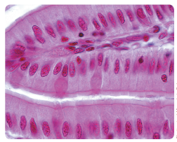
2.4 How cells make a body
Tissues
Epithelial tissue (or epithelium)
Covering or lining tissue, e.g. outer layer of the skin.
Organs including the heart, kidneys, intestines, liver and lungs are covered with epithelium. It also lines the inside of organs, e.g. the inner layer of the heart, stomach, intestines (see photo) and other hollow organs.
The cells that make up epithelium are very closely joined together. They vary in shape from thin and flat to column-shaped and cube-shaped, depending on the particular tissue.
Shutterstock/Jose Luis Calvo

Slide 27
2.4 How cells make a body
Connective tissue
Provides support for the body and helps to hold all the body parts together. Cells are not close together like they are in epithelium. They are separated from each other by large amounts of material that is not made of cells.
This non-cellular material is called matrix.
Connective tissues include bone, cartilage, tendons, ligaments and fat storage (adipose) tissue. Blood is often classified as a connective tissue. The matrix of blood is the liquid in which blood cells are suspended.

Slide 28
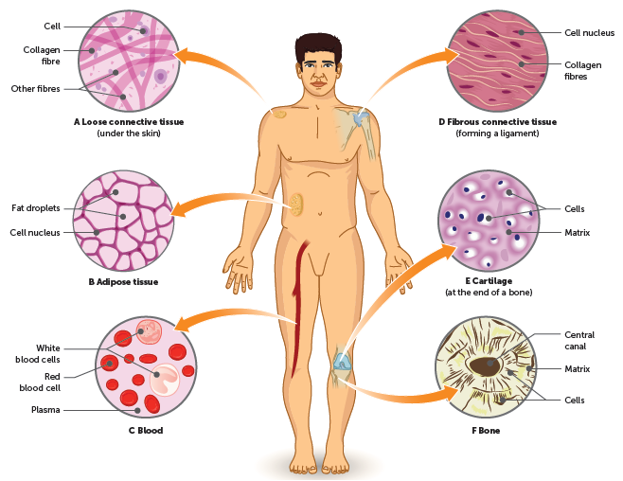
2.4 How cells make a body
Examples of connective tissue in the body

Slide 29
2.4 How cells make a body
Muscular tissue
The cells of muscular tissue, often called muscle fibres, are long and thin and can contract to become shorter. There are three different types of muscular tissue:
Skeletal muscle makes up the muscles that are attached to bones, e.g. in your arms and legs. We have voluntary control over these muscles, therefore it is sometimes referred to as voluntary muscle. Skeletal muscle fibres have striations across them, so are also referred to as striated muscle.
Smooth muscle does not have any striations, and is therefore also called non-striated muscle. It is found in the walls of the stomach and intestines, in the walls of blood vessels, in the iris of the eye, in the uterus and many other organs. We cannot contract smooth muscle voluntarily, so it may also be called involuntary muscle.
Cardiac muscle (also known as heart muscle) makes up most of the heart. When heart muscle contracts, it pumps the blood. Heart muscle cannot be voluntarily controlled.

Slide 30
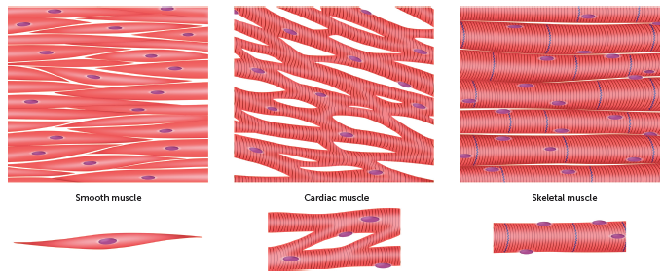
2.4 How cells make a body
Shutterstock.com/Aldona Griskeviciene
The three types of muscular tissue

Slide 31
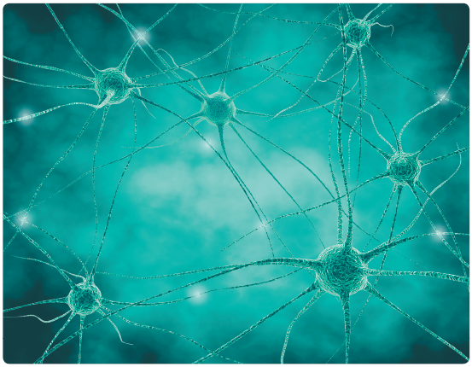
2.4 How cells make a body
Nervous tissue
Nervous tissue is made up of specialised nerve cells that are called neurons. Neurons have long projections from the body of the cell. When part of a neuron is stimulated, messages can be carried along these projections from one part of the body to another.
Nervous tissue is found in the brain, the spinal cord and the nerves.
Shutterstock.com/Illustration Forest

Slide 32
2.4 How cells make a body
Organs
Organs are body structures that are made up of two or more types of tissue. The tissues of an organ work together to carry out a particular task. For example, the heart is mostly muscle tissue, but it is covered and lined with epithelium. It also contains nervous tissue to make the muscle contract. All these tissues work together to pump the blood, which is a connective tissue.
Organs are distinct structures that usually have a recognisable shape.
Some large organs have smaller organs within them. The skin is the largest organ in the body and within it are many smaller organs, such as the sweat glands, nerves, hair and nails.

Slide 33
2.4 How cells make a body
Systems
The various organs are organised into body systems, sometimes called organ systems. A system is a group of organs that work together to carry out a particular task. For example, the role of the digestive system is to break down food and to absorb it into the blood. Some of the organs that work together to allow the digestive system to carry out these tasks are the mouth, stomach, intestines and liver.
Other major body systems include respiratory, circulatory, excretory, nervous, endocrine, skeletal, muscular, immune and reproductive systems.

Slide 34
2.4 How cells make a body
The organism
All the body systems work together to meet the needs of a functioning organism. No system can work in isolation; they all depend on each other. Heart muscle needs oxygen, which the respiratory system supplies; brain cells need nutrients, which are absorbed by the digestive system and transported by the circulatory system, and so on.
Some organs are part of more than one system. The pancreas is part of both the digestive system and the endocrine system. Therefore, organs such as the pancreas further contribute to the integration of the parts of the body.

